Slide 1
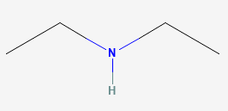
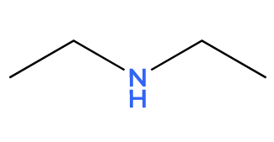
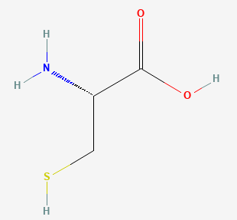
Known structure
Prediction
Dataset summary
Training
Fingerprint calculation
Compound | pH | logIE
 | 2.7 | 2.84
 | 2.7 | 2.81
cysteine | 2.7 | 0.93
 | 3.9 | 2.43
 | 5.1 | 2.26
 | 8.0 | 1.89
Fingerprints
pH
logIE
+
1.45
Molecular fingerprint
Fingerprint calculation tools
+
0.55
Test
Molecular fingerprint
…
Fingerprint calculation tools
+
3.15

